Slide 1
PROJECT
EMPLOYEE ABSENTEEISM ANALYTICS

Slide 2
PROJECT
EMPLOYEE ABSENTEEISM ANALYTICS

Slide 3
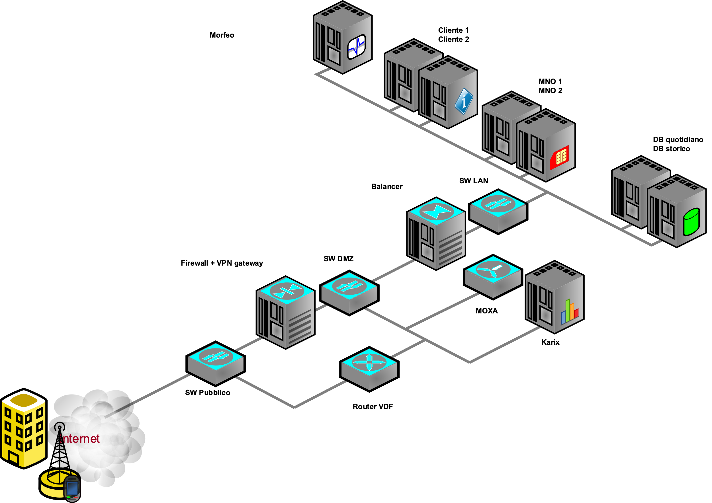
Steps

Slide 4
Steps

Slide 5
Steps

Slide 6
Steps

Slide 7
Data Cleaning

Slide 8
Data Cleaning

Slide 9
Data Cleaning

Slide 10
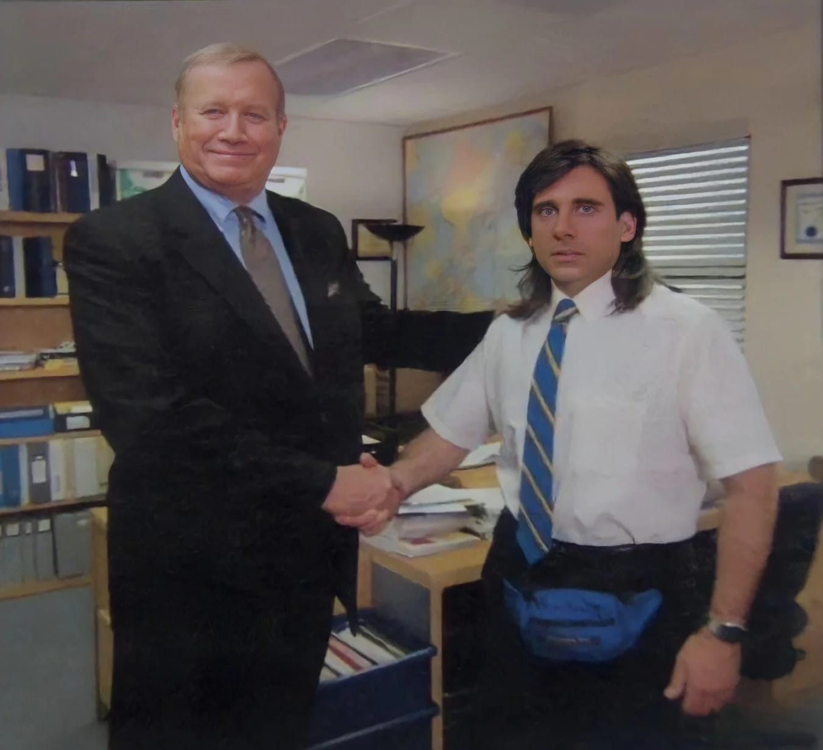
Gender Equality
Random Fictitious Data

Slide 11
PROJECT
EMPLOYEE ABSENTEEISM ANALYTICS

Slide 12
Data Cleaning

